Slide 1
NJ Civics 101

Slide 2
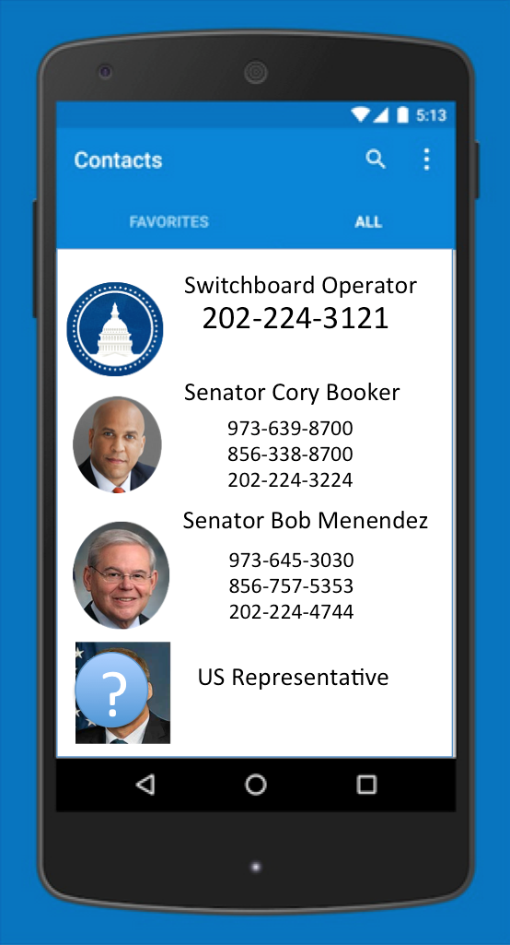
Key Numbers – Federal Level
These are your federal level elected officials.
Senator Cory Booker [D]
@CoryBooker
https://www.facebook.com/corybooker
Senator Bob Menendez [D]
@SenatorMenendez
https://www.facebook.com/senatormenendez
Find your congressional district:
http://njgin.state.nj.us/state/NJ_CongressionalDistricts/

Slide 3
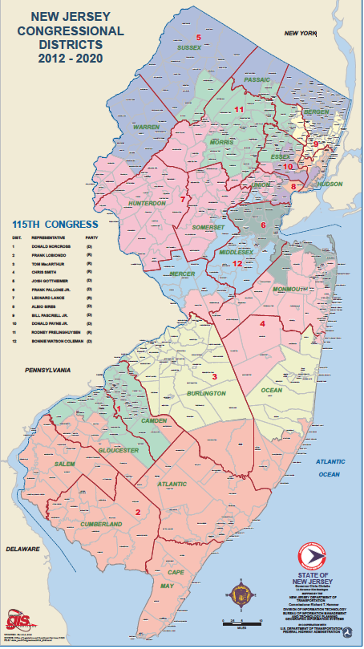
NJ Congressional Districts - 12
Find your congressional district:
http://njgin.state.nj.us/state/NJ_CongressionalDistricts/
There are 12 congressional districts in NJ.
Your US Representative votes on federal issues.

Slide 4
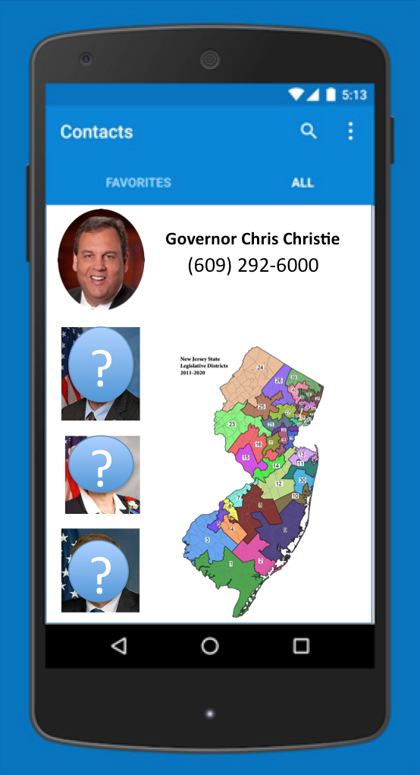
Key Numbers – State Level
Governor Chris Christie is head of the
Executive branch.
In the Legislative branch, you have 1 state
Senator and 2 members of the Assembly.
There are Legislative 40 districts. Find your legislative district here:
http://www.njleg.state.nj.us/districts/municipalities.asp
Bills are referred by both letters and numbers.
When calling your Senator – refer to “S” bills
When calling your member of Assembly – refer to “A” bills

Slide 5
Decreasing Order of Impact - 1
Office visit – you are the face and story to a bill.
Make an office appointment in order to talk to a higher level staffer.
Bring a letter to leave behind for your elected official.
Bring an advocate to provide the details and answers to technical questions.
Phone call – Make it short and sweet, about 1 minute.
What? State the issue that matters.
So What? Explain why concisely.
Now What? What action step do you want them to take?
*Remember to always include your name and zip code,
Example: “My name is [_] from [ZIP]and I’m concerned about Congress repealing the ACA. I have relatives who will lose their health insurance and have pre-existing conditions. And I don't want my Medicare drugs to get more expensive. Will Senator/Rep _______ oppose any repeal of the ACA?”
Fax, Tweet, Email: Tweeting gets the media’s attention, the public, and the attention of other elected officials.

Slide 6
#InsiderTIPS – from a former Senate Staffer
Calls are considered better than emails, which are considered better than postcards (decreasing levels of personal effort invested). But they're all absolutely better than not engaging at all. Engage with your government however you are able to. Email is open 24/7. The phone gets answered by a machine after office hours and, if not full, will allow you to leave a voice mail message.
These contacts literally get counted, so the Member learns what issues are most important to constituents each week. The staff certainly notices when the waiting room is full, or when the switchboard is lighting up. Counts are usually separated by call, email, letters and faxes, and office visits, and get reported out that way.
We don't recommend repeating a vehicle (e.g., call) for the same message. It’s better to get more unique constituents to contact on the same message. It is NOT helpful to the office to be badgered by the same person for the same message.

